Slide 1
Easy: Building cloud native full stack applications using Azure Static Web Application
L. (Van) Van Lowe
X (formerly Twitter) : lvanlowe
Email: van@nuttin-but.net

Slide 2

About Me
Over 4 decade as a professional developer (Before MS DOS)
various fortune 100 companies and various federal government agencies
over 2 decades as a web developer
Over 2 decades as an independent consultant
MS Computer Science
Over a decade presenting at user groups and code camps
Baby Boomer
Big Motown Fan

Slide 3
Objective
To demonstrate how to create full stack web applications using Azure Static Web Applications

Slide 4
Assumptions
Will not go into detail about angular
Will not go into detail about Azure Functions
You know something about web development

Slide 5
History
Angular Apps
C# Azure Functions
Facebook Logic
Azure DevOps

Slide 6
Beginning Build 2020
JavaScript Frontend
Angular
React
Vue

Slide 7
Beginning Build 2020
Azure Functions
JavaScript

Slide 8
Beginning Build 2020
Social Logons
Facebook
Google
Twitter
GitHub
Microsoft (AAD)

Slide 9
Beginning Build 2020
Custom domains
GitHub Actions
Roles
Free (preview)

Slide 10
Beginning Build 2020
Missing
No Azure Dev Ops
No C# Azure Functions
No Apple logins

Slide 11
frontends
Angular
React
Vue
Blazor
Gatsby
Etc.

Slide 12
Demo - Basic App

Slide 13
API backends
Azure Functions
Azure API Management
Azure App Service
Azure Container Apps

Slide 14
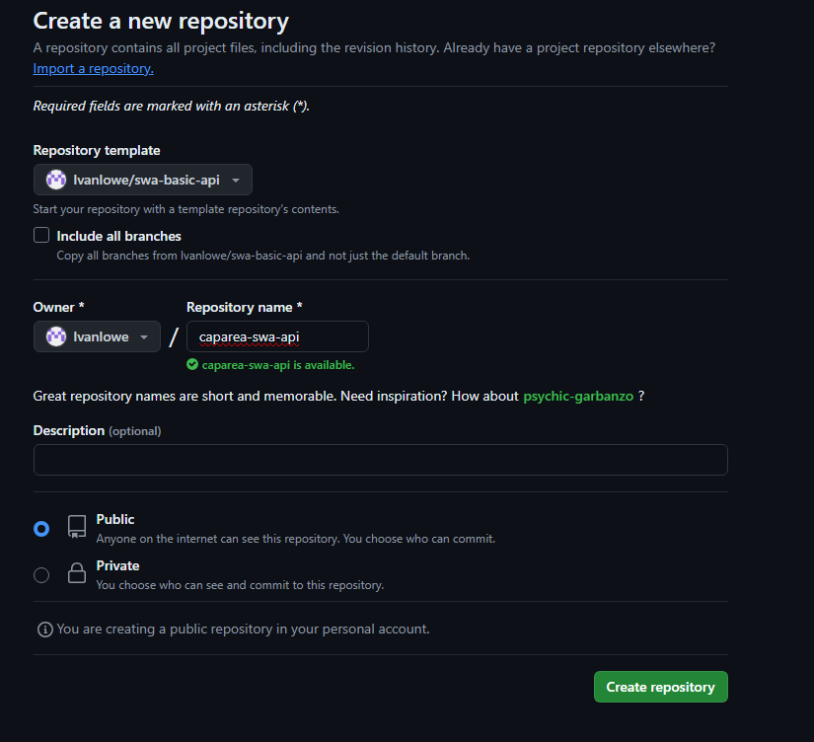
Github - create repo

Slide 15
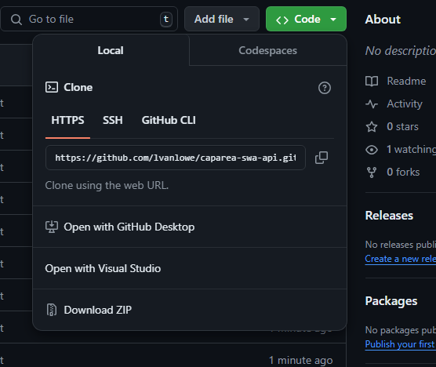
Github - clone repo

Slide 16
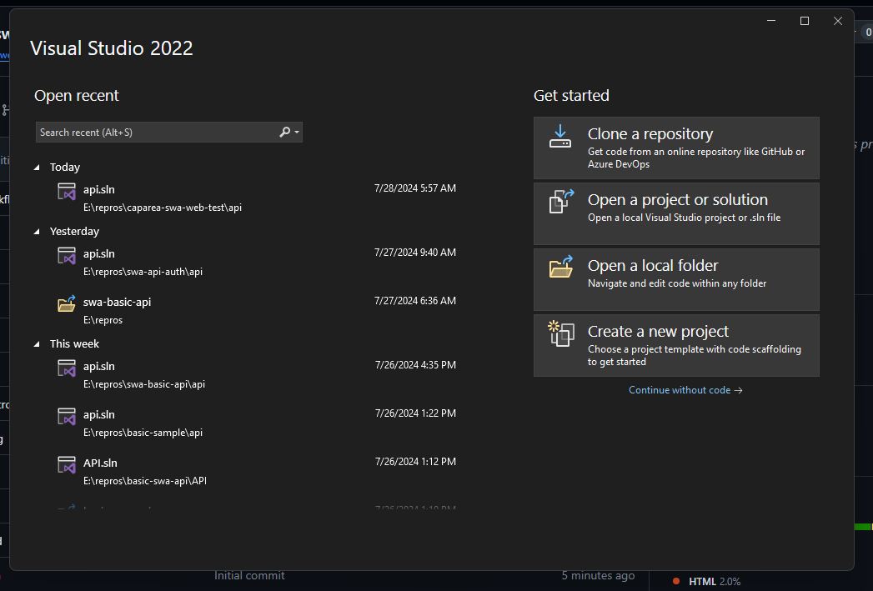
Open Visual Studio

Slide 17
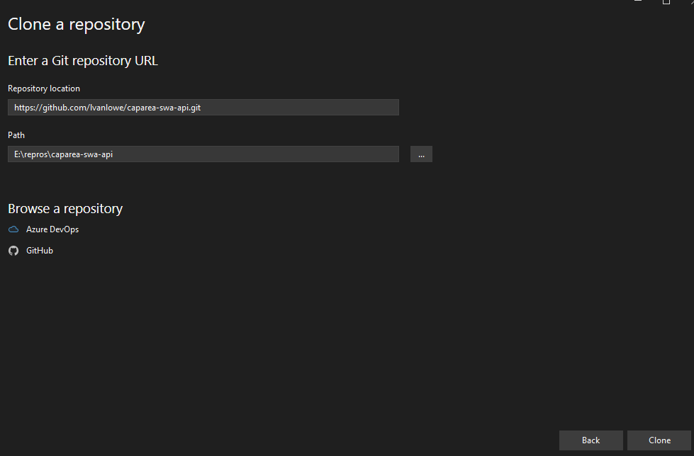
VS - Clone Repo

Slide 18
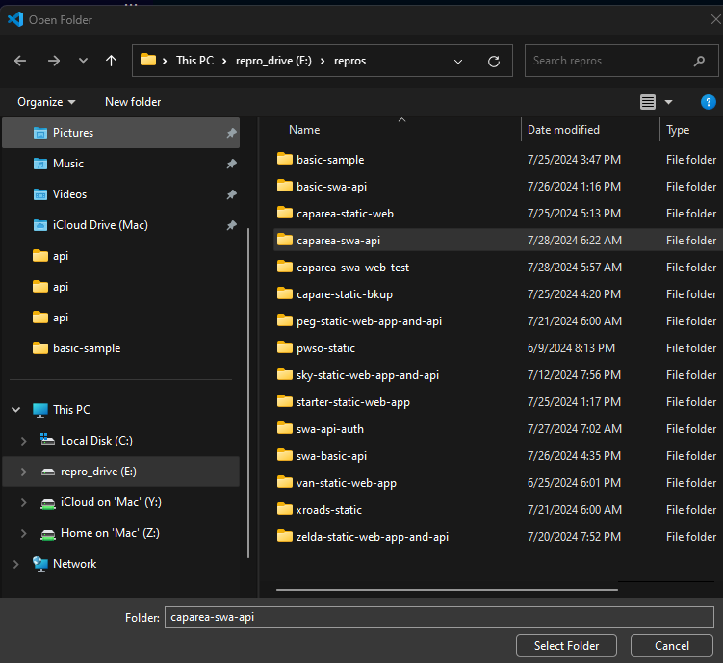
Open folder VSCode

Slide 19
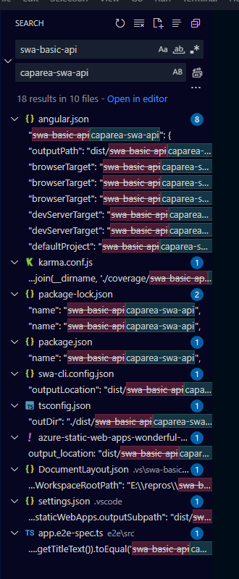
Vscode - Rename app name

Slide 20
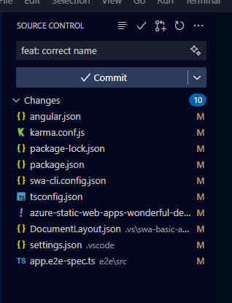
Vscode – commit changes

Slide 21
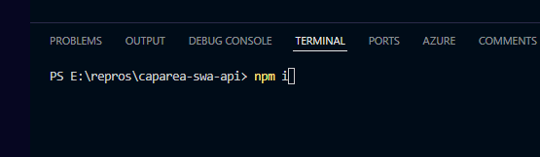
Vscode - Npm i

Slide 22
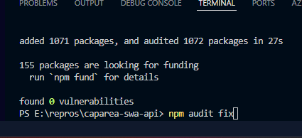
Vscode - NPM Audit

Slide 23
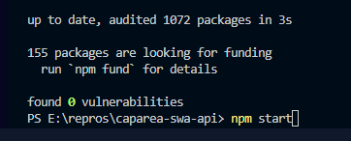
Vscode - Npm start

Slide 24
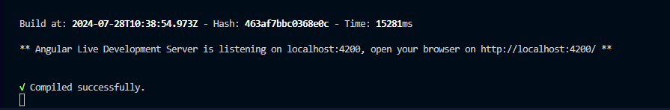
Vscode - Run client locally

Slide 25
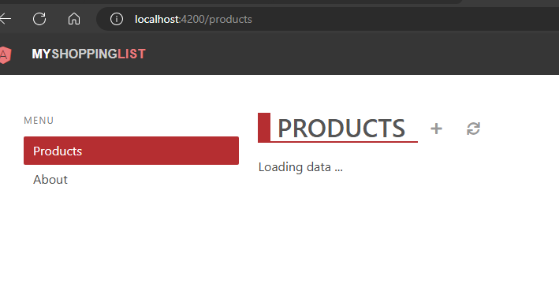
Browser - Running client locally

Slide 26
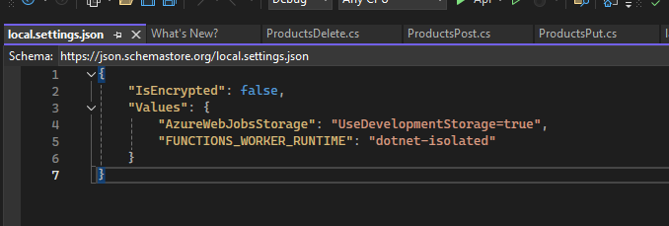
Vs - Add local settings

Slide 27
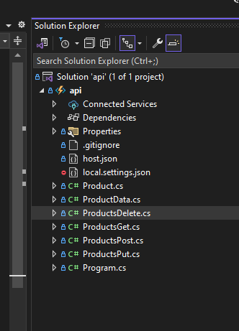
Vs - Azure functoins

Slide 28
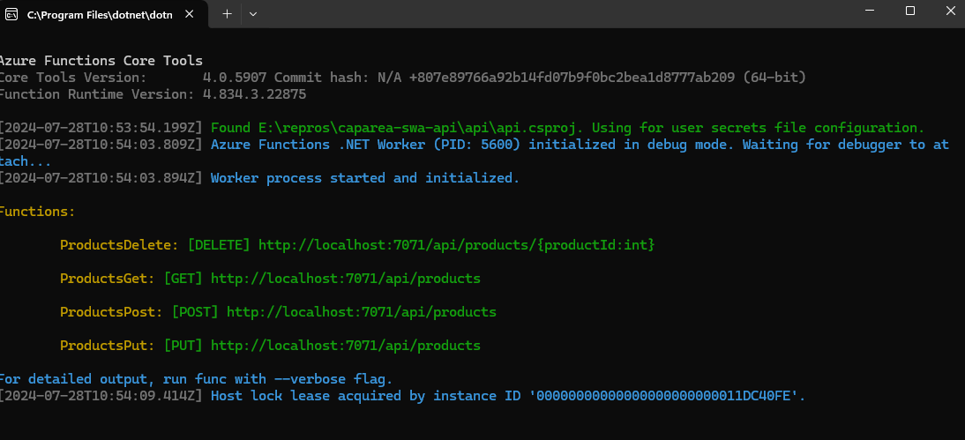
Vs - Running api locally

Slide 29
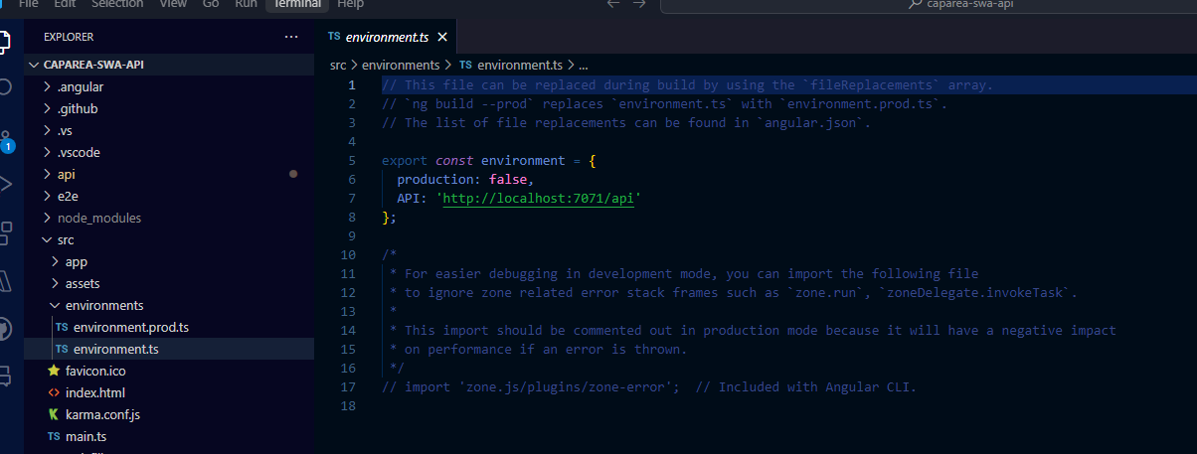
Vscode - Update Environment

Slide 30
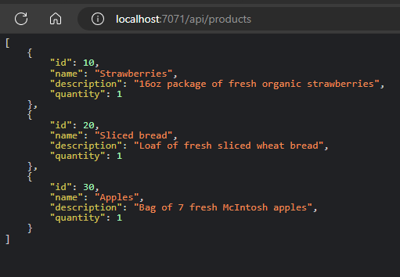
Browser - Running api locally

Slide 31
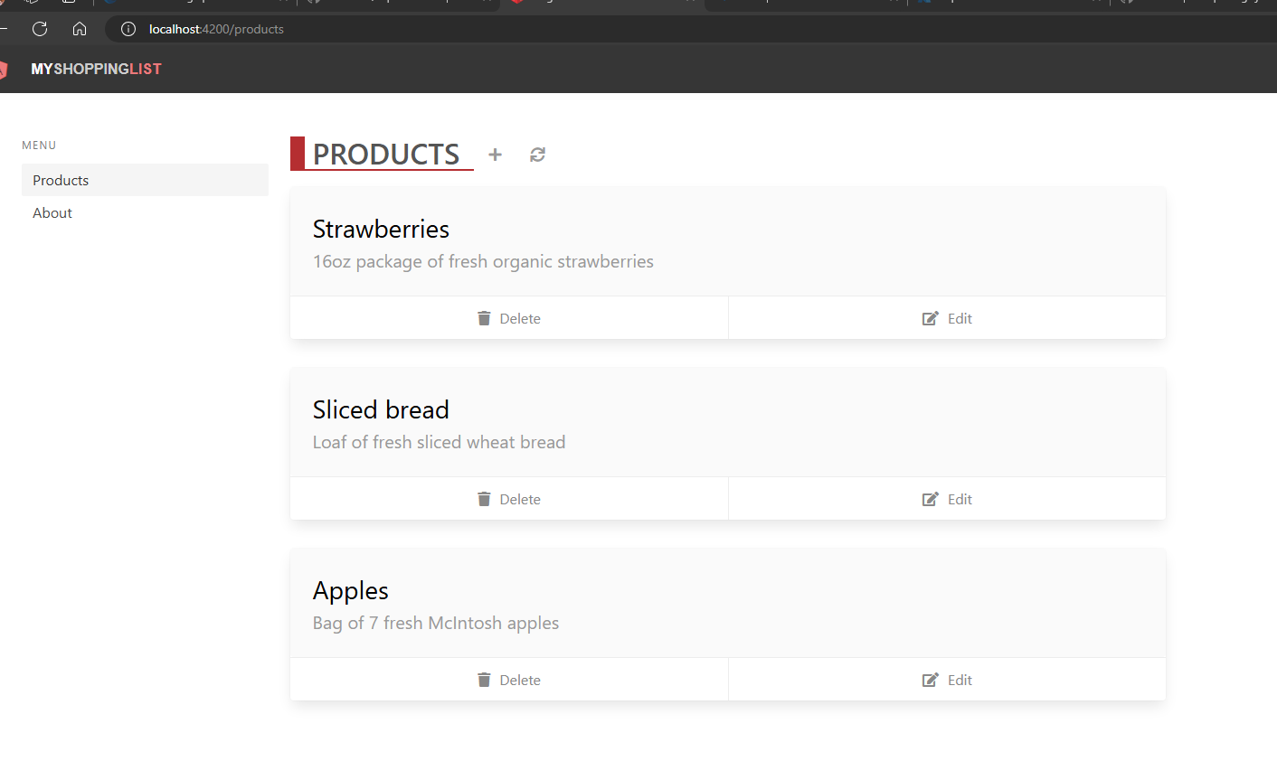
Broswer - Running client and API locally

Slide 32
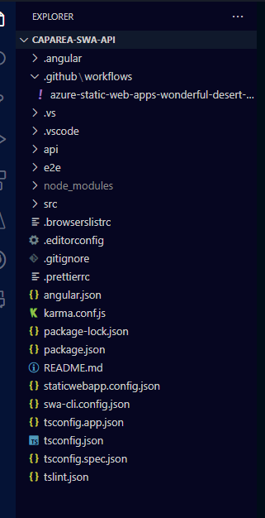
Vscode - Remove workflow file

Slide 33
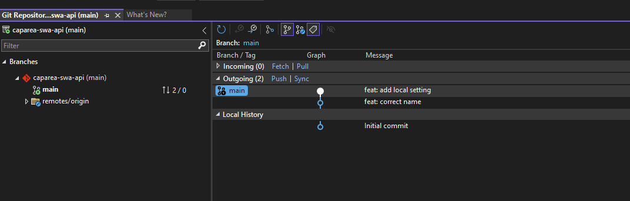
Vs - Push Commits

Slide 34
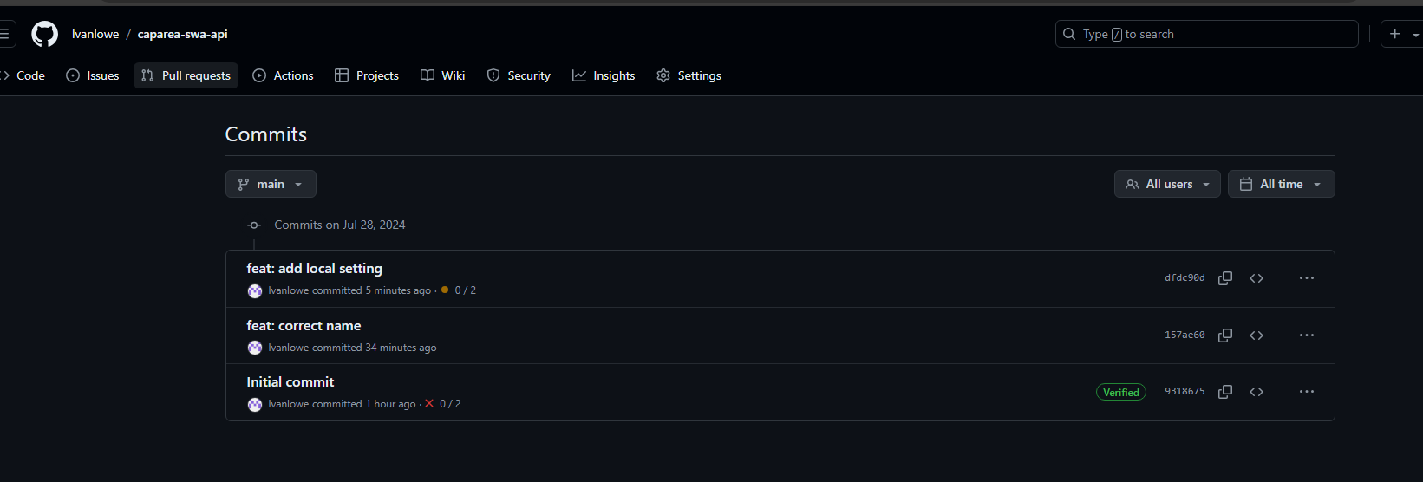
GITHUB commits

Slide 35
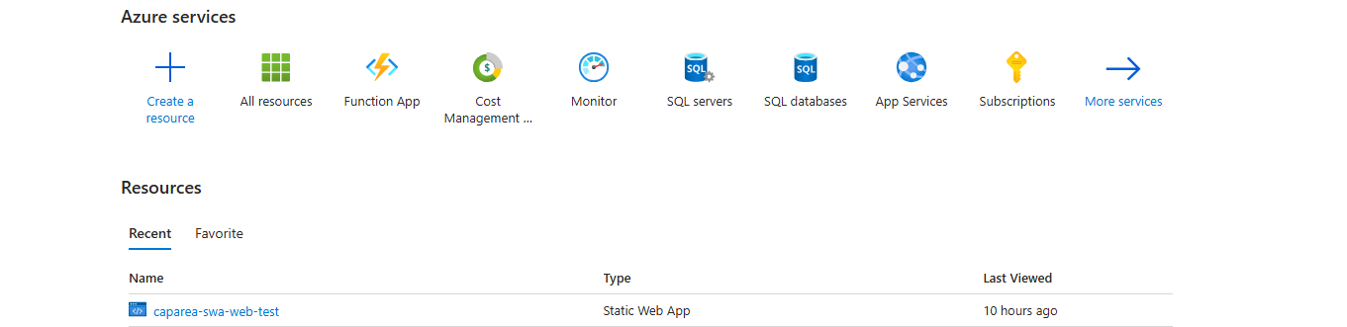
Azure portal - Create a Resource

Slide 36
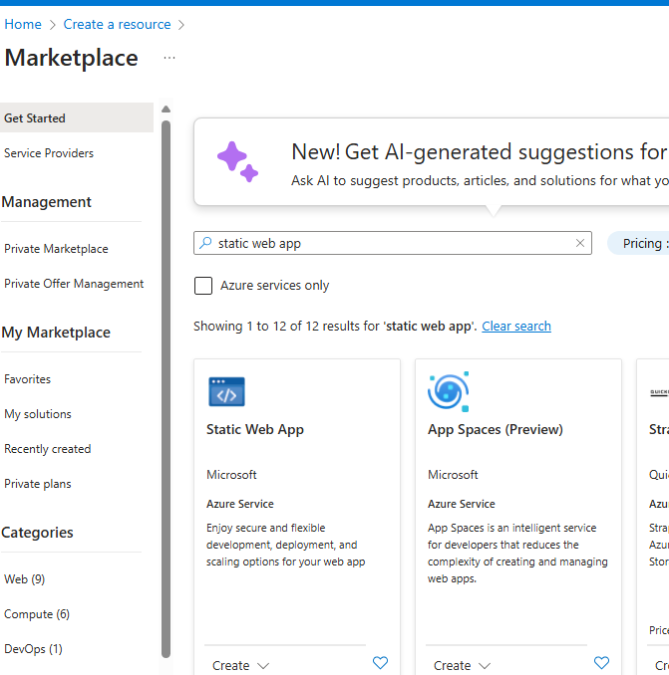
Azure portal – select static web app

Slide 37
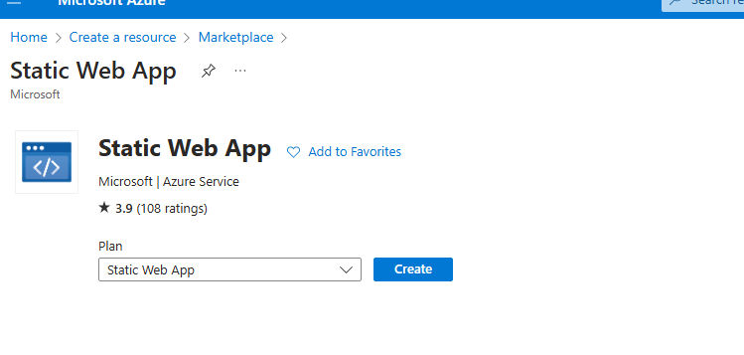
Azure portal – create static web app

Slide 38
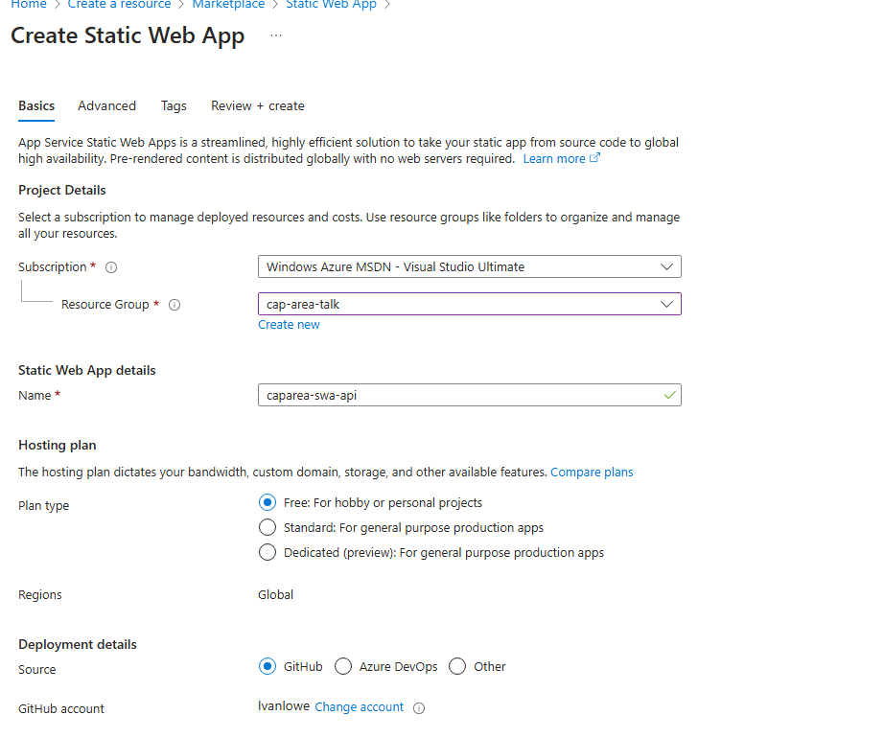
Azure portal – create static web app

Slide 39
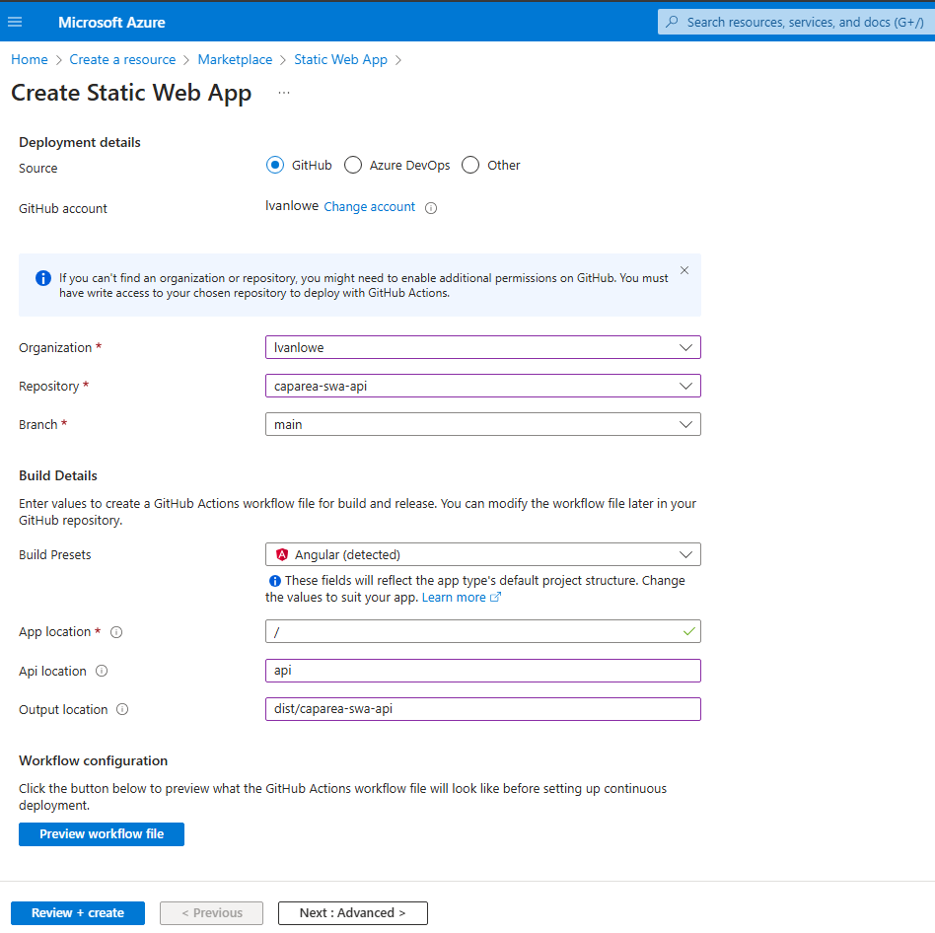
Azure portal – create static web app

Slide 40
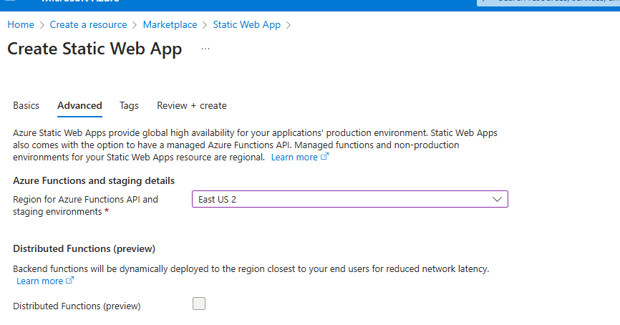
Azure portal – create static web app

Slide 41
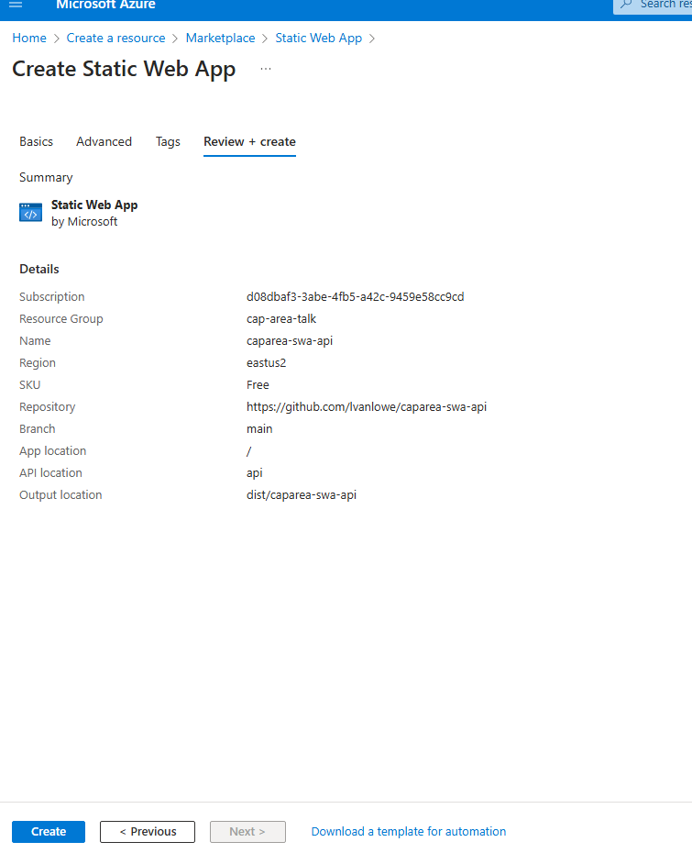
Azure portal – create static web app

Slide 42
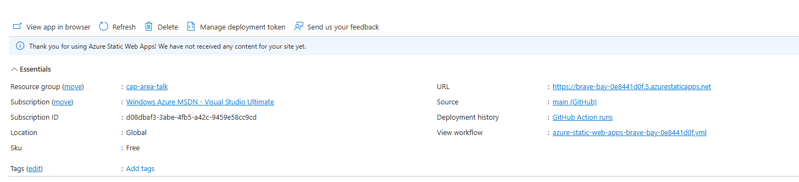
Azure portal – Review static web app

Slide 43
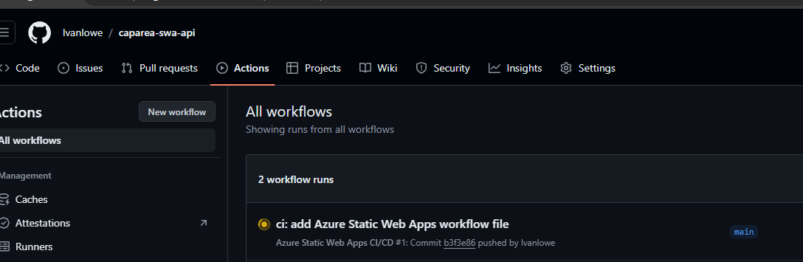
GIT HUB – Actions deploying

Slide 44
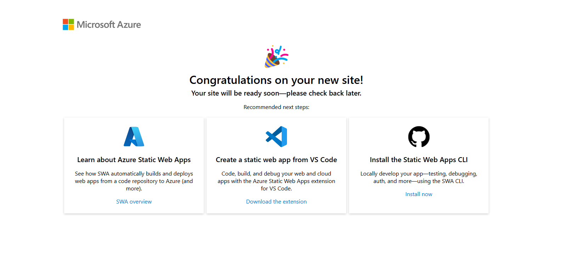
Browser– Waiting for site

Slide 45
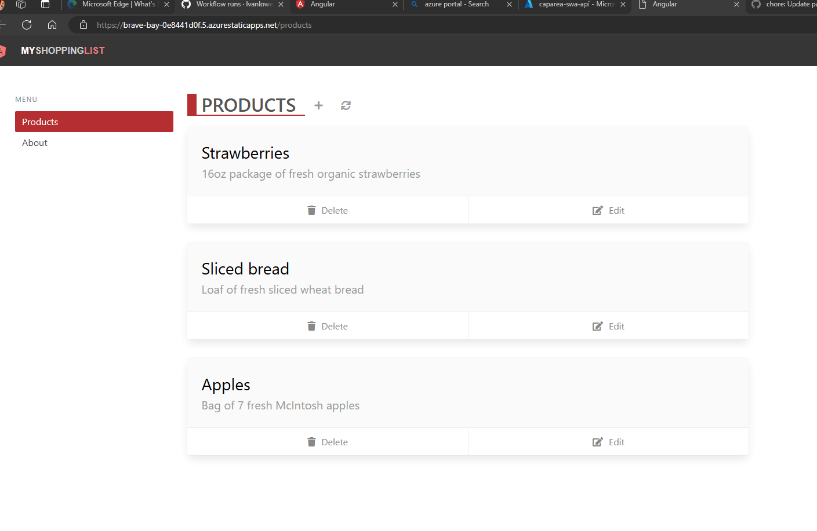
Browser–site ready

Slide 46
Identity Providers
Microsoft
Apple
Facebook
GitHub
Google
X (Twitter)
OpenID Connect

Slide 47
Demo Auth

Slide 48
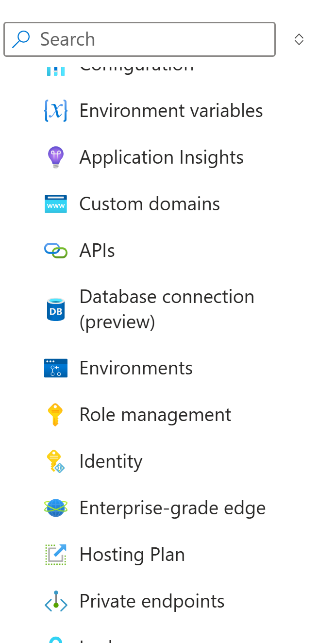
Azure portal – role

Slide 49
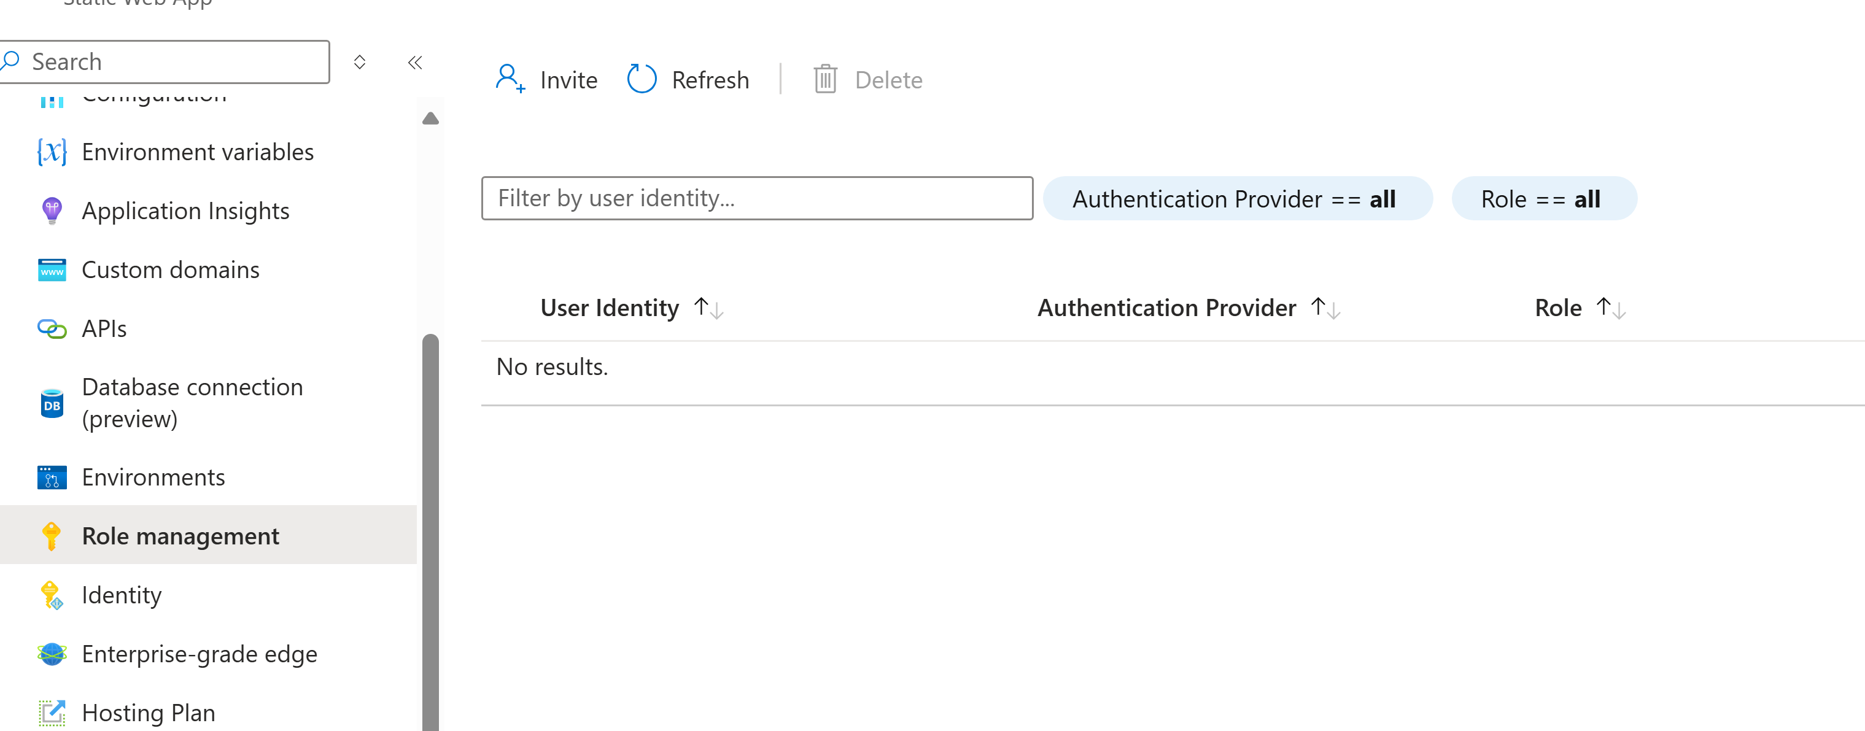
Azure portal - role

Slide 50
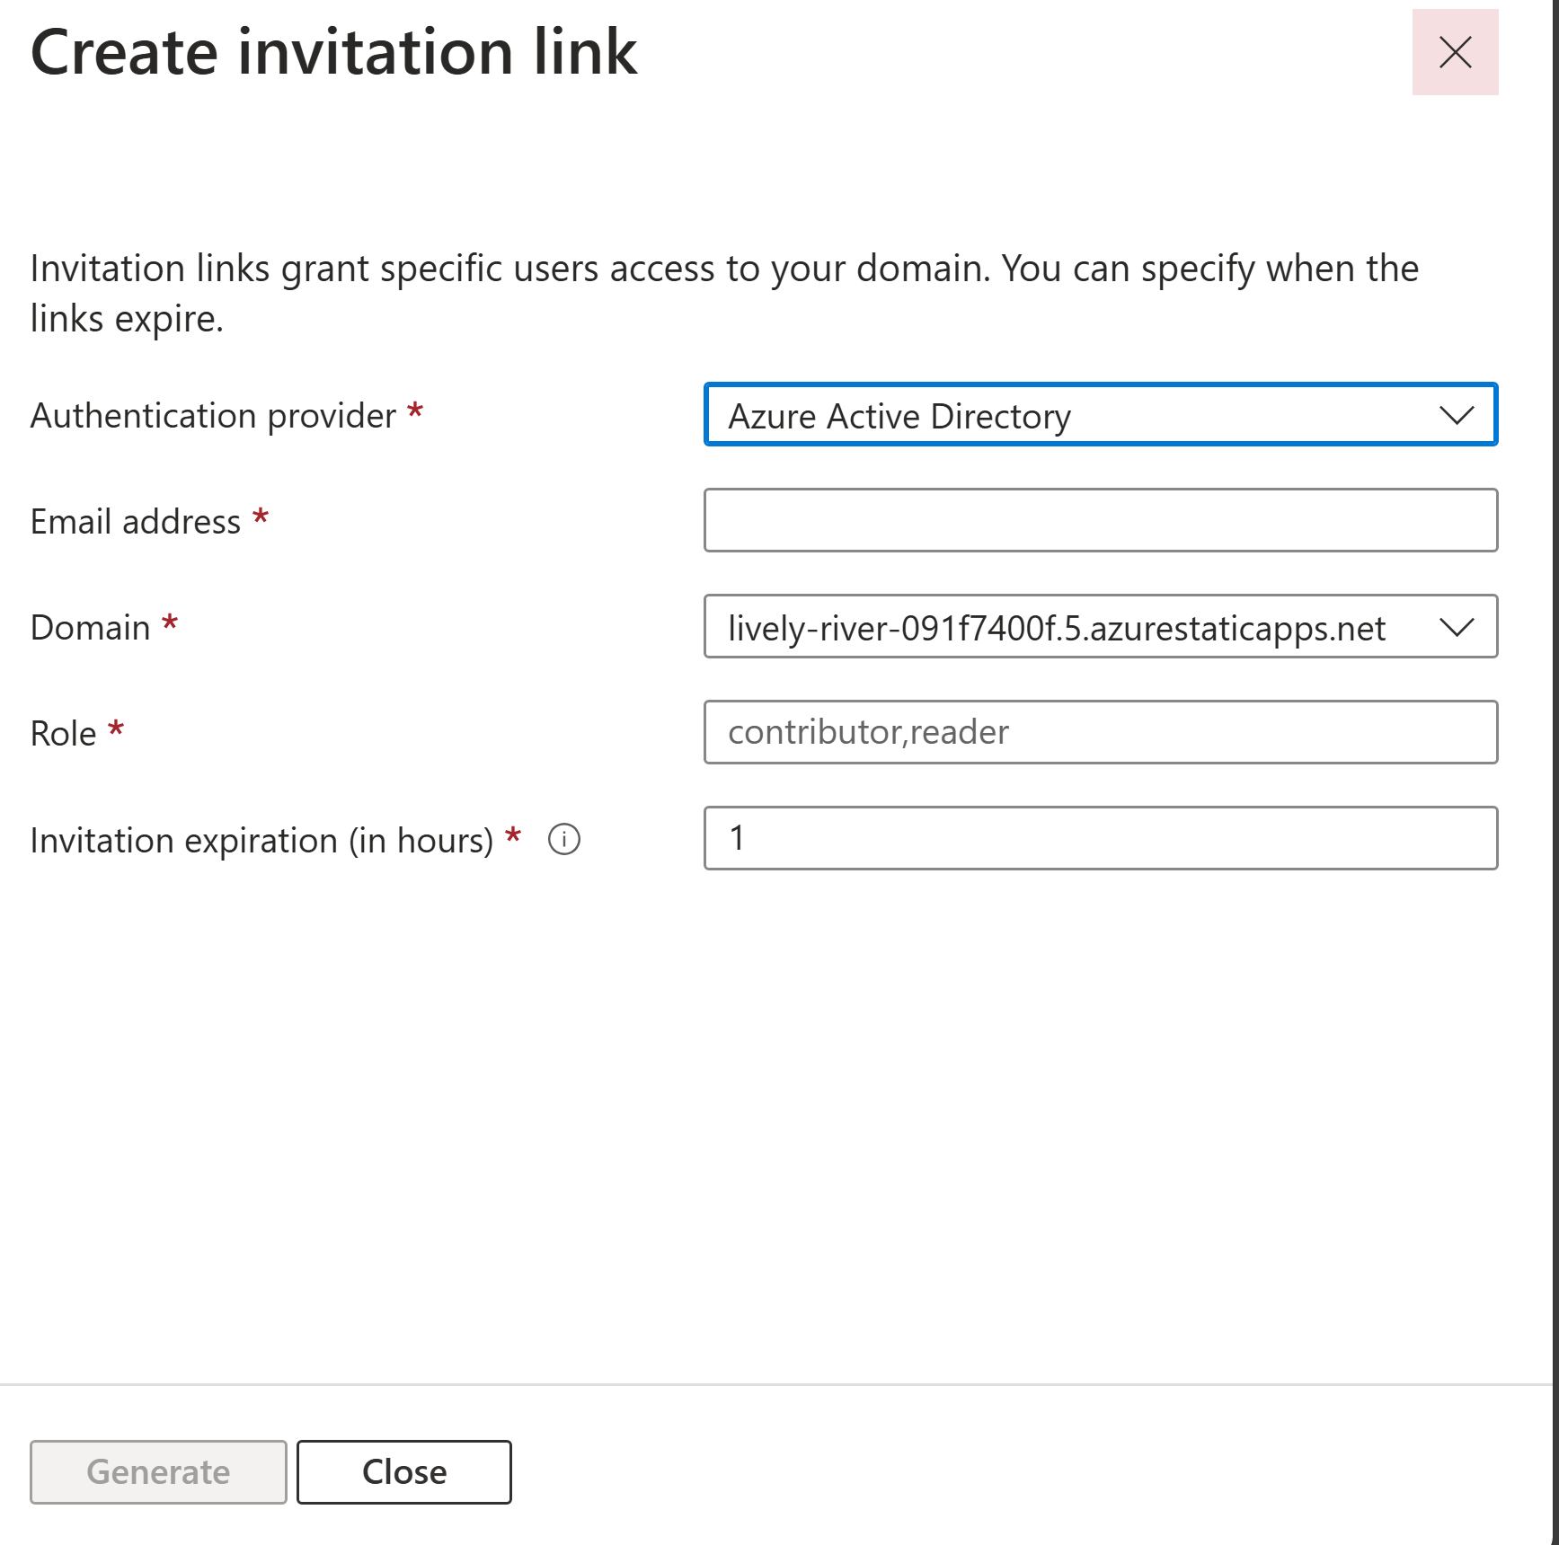
Azure portal – create link

Slide 51
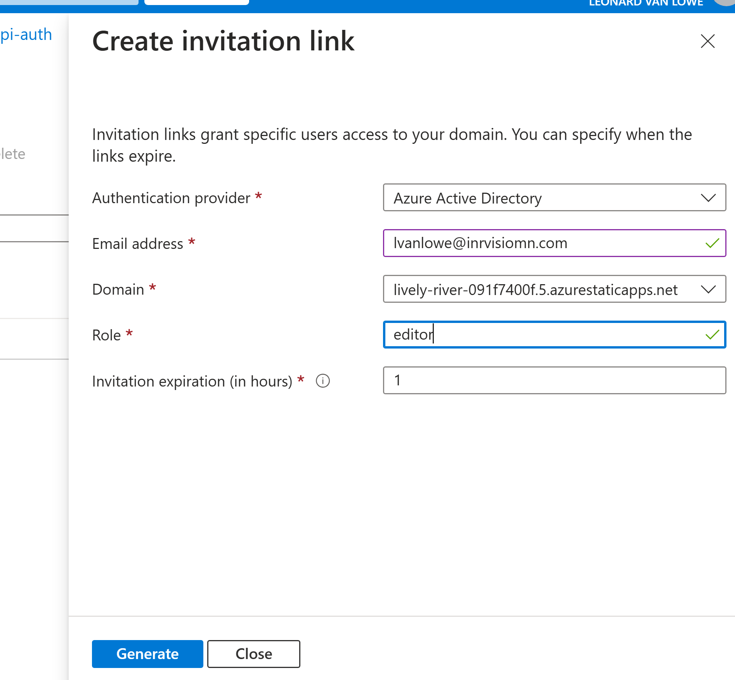
Azure portal – add role

Slide 52
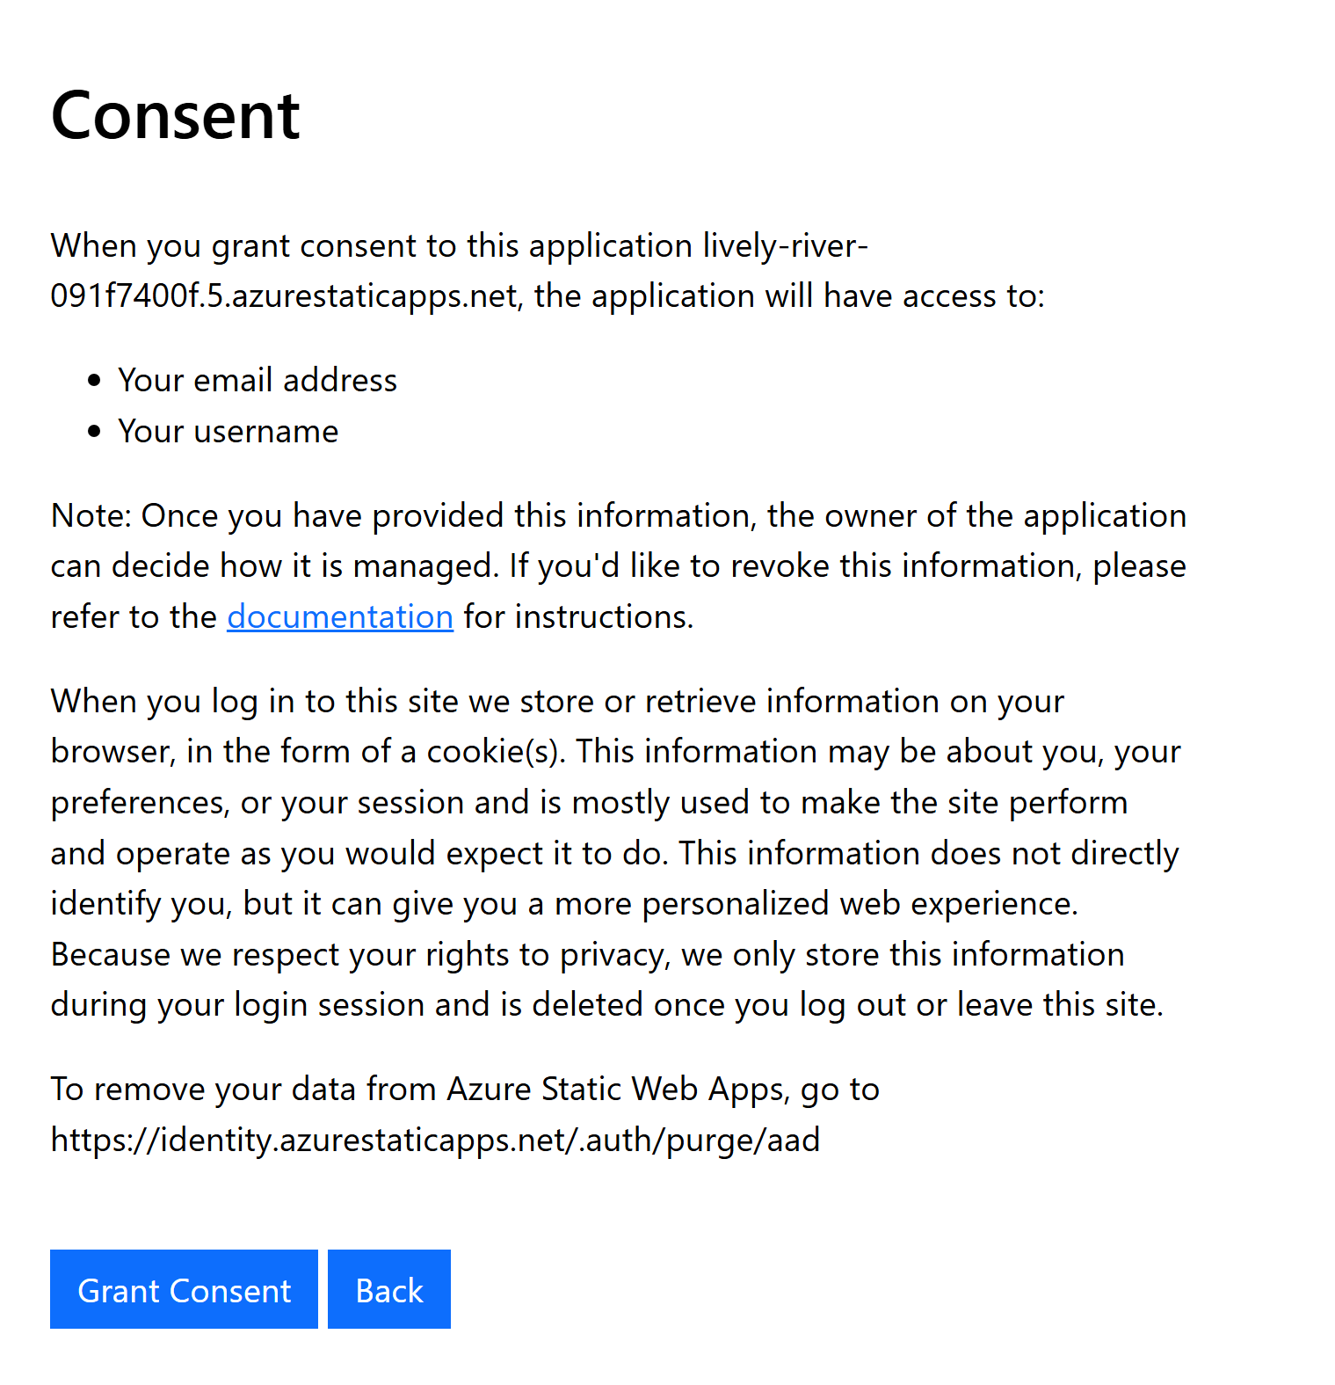
Azure portal – consent for role

Slide 53
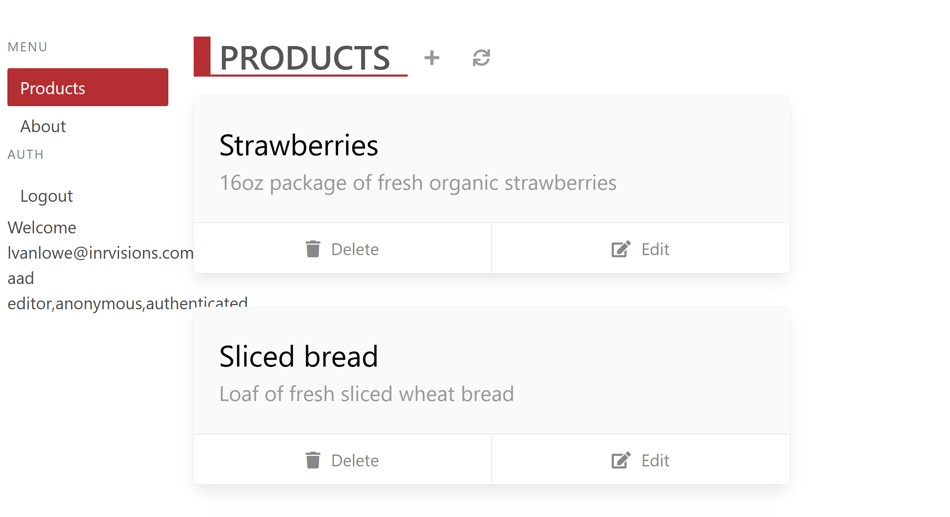
Browser – auth

Slide 54
Custom domains

Slide 55
Resources
Mircosoft Learn
https://learn.microsoft.com/en-us/azure/static-web-apps/
https://learn.microsoft.com/en-us/training/paths/azure-static-web-apps/
GitHub Project
https://github.com/lvanlowe/basic-sample
https://github.com/lvanlowe/swa-basic-api
https://github.com/lvanlowe/caparea-static-web
https://github.com/lvanlowe/caparea-swa-api
https://github.com/lvanlowe/caparea-swa-api-auth

Slide 56
Questions
? ?
?
?
?

